Slide 1
15IT496L MAJOR PROJECT UNUSUAL CHARACTERISTICS OF ANIMAL RECOGNITION IN A HERD USING PREDICITION TECHNIQUES
Aditya Tekur(RA1511008010094)
Mahin Husen(RA1511008010030)
Preethika SP(RA1511008010179)

Slide 2
INTRODUCTION
Our proposed system takes a new unlabelled video sequence and multiple labelled video sequences representing different types of possible events.
There is a production of the visualized content in the unlabelled video sequence as an output to the user. The user can adapt this visualization according to their preferences (i.e. what type of event they consider to be abnormal) using the Video Analysis Tool interface.
By using the deep learning model we aim to achieve the accuracy which shall help in the characteristic identification.

Slide 3
OBJECTIVE
We aim to implement the Deep learning concept to predict unusual characteristics in animal. More suitable for poultry animals. Animals just like humans tend to show odd behavior when they are ill or not right . It may be a show of over-activeness or a state of dullness.
These characteristics if not identified can affect and cause diseases which can spread to other animals and might even be passed on to human beings when their products are consumed. Characteristic identification of the animal will help in the detection of any diseases such that its spreading can be restricted and can save a fortune for the owner/caretaker of these animals.

Slide 4
LITERATURE SURVEY
1) Predicting animal behavior using deep learning: GPS data alone accurately predict diving in seabirds - Ella Browning, Mark Bolton , Ellie Owen, Akiko Shoji, Tim Guilford, Robin Freeman
This paper addresses the behavior of seabirds using a combined GPS and TDR dataset from 108 individuals by training deep learning models to predict characteristics. The variables used to train these models are those recorded solely by the GPS device: variation in longitude and latitude, altitude and coverage ratio. Mapping these predictions provides useful insights into the foraging activity of a range of seabird species, highlighting important at sea locations.
2) Image motion feature extraction for recognition of aggressive behaviors among group-housed pigs - Chen Chen , Weixing Zhu , Changhua Ma , Yizheng Guo , Weijia Huang , Chengzhi Ruan
The objective of this paper is to develop a computer vision-based method to further separate the aggressive pigs from all the moving individuals and to automatically recognize aggressive behaviors by analyzing their acceleration between adjacent frames.

Slide 5
3) Automatically identifying, counting, and describing wild animals in camera-trap images with deep learning - Mohammad Sadegh Norouzzadeha, Anh Nguyenb, Margaret Kosmalac, Alexandra Swansond, Meredith S. Palmere, Craig Packere, and Jeff Clune.
The deep neural networks automatically identify animals with >93.8% accuracy, and it was expected that number to improve rapidly in years to come. Through this they want to harness deep learning to automatically extract necessary features to detect, count, and describe animals colour and shape and apply these methods on the world’s largest dataset of wild animals because such features can be transferred to other domains with small datasets.
4) Feature Extraction With Deep Neural Networks by a Generalized Discriminant Analysis - André Stuhlsatz, Jens Lippel, Thomas Zielke(IEEE 2012)
It is an approach to feature extraction that is a generalization of the classical linear discriminant analysis (LDA) on the basis of deep neural networks (DNNs).

Slide 6
5) Feature Extraction Using Deep Learning for Food Type Recognition - Muhammad Farooq, Edward Sozonov(2017)
These images can be used for automatic recognition of foods present and potentially providing an indication of eating habits. Traditional methods rely on computing a number of user derived features from image and then use a classification method to classify food images into different food categories.
6) Deep Feature Extraction and Classification of Hyperspectral Images Based on Convolutional Neural Networks- Yushi Chen, Hanlu Jiang, Chunyang Li, Xiuping Jia, Pedram Ghamisi (IEEE 2017)
The proposed approach employs several convolutional and pooling layers to extract deep features from HSIs, which are nonlinear, discriminant, and invariant. These features are useful for image classification and target detection.

Slide 7
7) Deep Learning feature Extraction for Image Processing -Baptiste Wicht
The scope of this work is defined by several machine learning tasks. The first one, handwritten digit recognition, is analysed to see how much the unsupervised pretraining technique introduced with the Deep Belief Network (DBN) model improves the training of neural networks.
The second, detection and recognition of Sudoku in images, is evaluating the efficiency of DBN and Convolutional DBN (CDBN) models for classification of images of poor quality. Finally, features are learned fully unsupervised from images for a keyword spotting task and are compared against well-known handcrafted features.
8) Animal Recognition System Based on Convolutional Neural Network - Tibor TRNOVSZKY, Patrik KAMENCAY, Richard ORJESEK, Miroslav BENCO, Peter SYKORA
In this paper, the Convolutional Neural Network (CNN) for the classification of the input animal images is proposed.

Slide 8
9) Animal Recognition and Identification with Deep Convolutional Neural Networks for Automated Wildlife Monitoring - Hung Nguyen, Sarah J. Maclagan, Tu Dinh Nguyen, Thin Nguyen, Paul Flemons ,Kylie Andrews, Euan G. Ritchie. Dinh Phun
Automatic covert cameras or "camera traps" are being an increasingly popular tool for wildlife monitoring due to their effectiveness and reliability in collecting data of wildlife unobtrusively, continuously and in large volume. However, processing such a large volume of images and videos captured from camera traps manually is extremely expensive, time-consuming and also monotonous.
This presents a major obstacle to scientists and ecologists to monitor wildlife in an open environment. Leveraging on recent advances in deep learning techniques in computer vision, we propose in this paper a framework to build automated animal recognition in the wild, aiming at an automated wildlife monitoring system.

Slide 9
10) Wild-Animal Recognition in Agriculture Farms Using W-COHOG for Agro-Security - Nagaraju Andavarapu and Valli Kumari Vatsavayi
Computer Vision is applied in agriculture field for food grading, disease identification of the plants and agro-farms security. Huge crop damage is caused by the wild animal attacks on the agriculture farms. Here are some traditional techniques followed by the local farmers, but which are not effective.
This problem can be solved using computer vision techniques. In this paper, we proposed an algorithm to detect animals in a given image. WCoHOG is a Histogram oriented gradients based feature vector with better accuracy. It is an extension of Co-occurrence Histograms of Oriented Gradients (CoHOG).
In this paper LIBLINEAR classifier is used in order to get better accuracy for high dimensional data. The experiments were conducted on two benchmark datasets called Wild-Anim and CamaraTrap dataset. Experimental results prove that W-CoHOG performs better than existing state of the art methods

Slide 10
EXISTING SYSTEM
At present, there are systems that are able to extract the images from the videos and are able to do the recognition from the source of the wanted object.
The identification of the characteristics of the non-living objects like fruits and other entities are present on hand, but there is no system currently present that is able to identify the characteristics of the living entity such has human beings or animals.
The Joint efforts from researchers from the University of Wyoming, Auburn University, Harvard University, University of Oxford, University of Minnesota, Uber AI Labs has resulted in an accurate method for automated animal identification from camera-trap images.
The researchers used Deep Learning techniques and large labeled datasets to address the problem of automated animal identification in the wild.

Slide 11
ISSUES IN EXISTING SYSTEM
The existing systems so far have failed to characterize these attributes/features and thus have been the main reason why so many poultry farmers face losses through out the world
The Chinese have so far come up with a set up that caters for and is able to identify the problems of a pig, but has un abled to do anything so far for all other poultry animals.
The features are extracted in many systems but none are able to make any conclusion or result based on the findings.
Before the characteristics identification process, the video of the length 24 hrs must be recorded and fed into the system.
There can be network issues when uploading the video into the database through wireless medium. The systems present now uses older generation connectivity such as 3G or ZigBee.

Slide 12






PROPOSED SYSTEM ARCHITECTURE
STORAGE MEDIUMS
SEQUENTIAL MODEL RUNS ON TEST DATASET
O/P USED TO PRINT BORDERS TO DISPLAY CHARACTER AND ID THE ANIMAL
CONVERT FRAMES
BACK TO VIDEO
VIDEO DISPLAY
FRAMES
STORED AS TESTING DATASET
CONVERSION OF VIDEO TO FRAMES
VIDEO INPUT
CAMERA

Slide 13
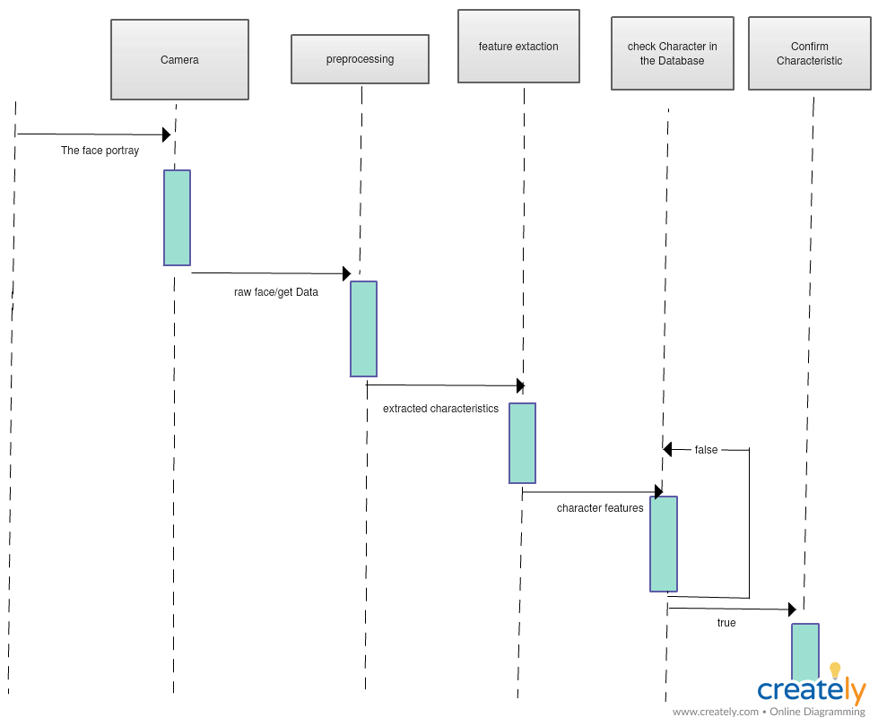
PROPOSED SYSTEM DATA FLOW
SEQUENCE DIAGRAM

Slide 14
MODULE SPLIT AND EXPLAINATION OF EACH MODULE
The various components that we have used in our project are:
Programming
We have used Python Programming in order to achieve our objective of creating this system.
Web Technology
The data sets for training the machine have been taken from the Internet. Once the process is complete, the characteristics can be searched over the Internet such that the owner can get more information regarding the disease.
Database
The video used for characteristic identification and the data sets are stored in a excel sheet.
Human Computer Interaction
The UI/UX design used will be simple and intuitive such that the user has no difficulty in using the application
Networking
The application will be connected to the Internet through the WIFI.

Slide 15
IMPLEMENTATION PROCEDURE, CODE SNIPPET, TOOL USED
Our project makes use of a video, shot from a camera and the implementation of a Sequential model as well as make use of the SSD algorithm to identify and characterize the sheep’s depicted in the video.
The Sequential model is trained using the Training dataset which contains static images of sheep’s and the attribute/characteristics depicted by those sheep’s that are stored in a CSV file. The Testing dataset contains the images that are extracted from the input video as frames.
The Testing dataset is passed through the Sequential model to get the characteristics/attributes depicted by the sheep in each frame and store those characteristics/attributes in a CSV file.

Slide 16
The SSD Algorithm is trained on identifying the various animals and not only does it display the name of the animal detected, it displays the confidence percentage of the animal as well, we in our project have used it for identifying sheep.
The above stated algorithm also creates a border around the identified sheep such that it can be used for tracking purposes during the entirety of the video. The SSD Algorithm also takes in the attributes depicted by these frames and displays them along the border which identifies the sheep. These frames are then combined back to get the output video. Through the output video, the poultry /owner will easily be able to identify the animal showing unusual behavior and be able to separate it from the rest of the group such that it does not cause any further damage to the rest of the animals.

Slide 17
MAJOR TOOLS USED
NUMPY, SCIPY, OPENCV, PANDAS
SEQUENTIAL MODEL CODE SNIPPET
model = Sequential()
model.add(BatchNormalization(input_shape=Xtrain.shape[1:]))
model.add(Conv2D(32, kernel_size=(3, 3), activation= 'relu'))
model.add(Conv2D(64, kernel_size=(3, 3), activation= 'relu', padding='same'))
model.add(Conv2D(64, kernel_size=(3, 3), activation= 'relu'))
model.add(MaxPooling2D(pool_size=(2,2)))
model.add(Dropout(0.25))
model.add(Flatten())
model.add(Dropout(0.5))
model.add(Dense(6, activation='sigmoid'))
# to check the model summary
model.summary()

Slide 18
SSD ALGORITHM CODE SNIPPET
Net=cv2.dnn.readNetFromCaffe("MobileNetSSD_deploy.prototxt.txt","MobileNetSSD_deploy.caffemodel")
# load the input image and construct an input blob for the image
# by resizing to a fixed 300x300 pixels and then normalizing it
# (note: normalization is done via the authors of the MobileNet SSD
# implementation)
data = pd.read_csv('result.csv')
c = 0
k = 0
for img_path in tqdm(test.Image_name.values):
image1 = cv2.imread(TEST_PATH + img_path)
(h, w) = image1.shape[:2]
blob = cv2.dnn.blobFromImage(cv2.resize(image1, (300, 300)), 0.007843, (300, 300), 127.5)

Slide 19
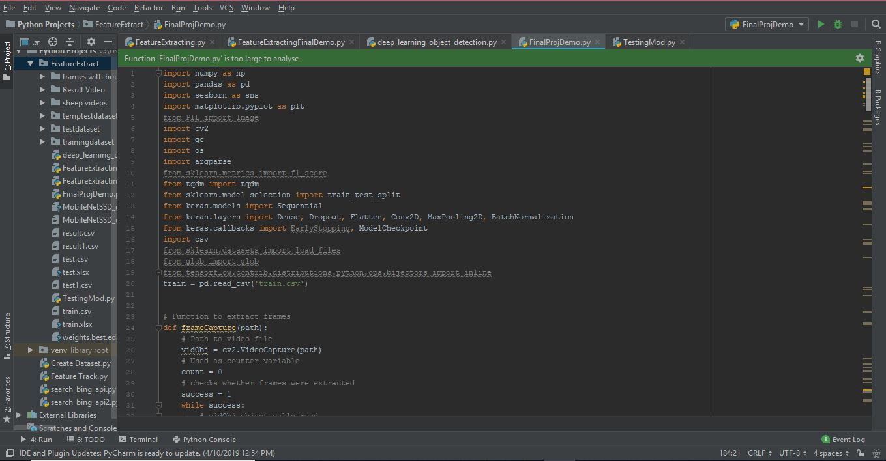
RESULT

Slide 20
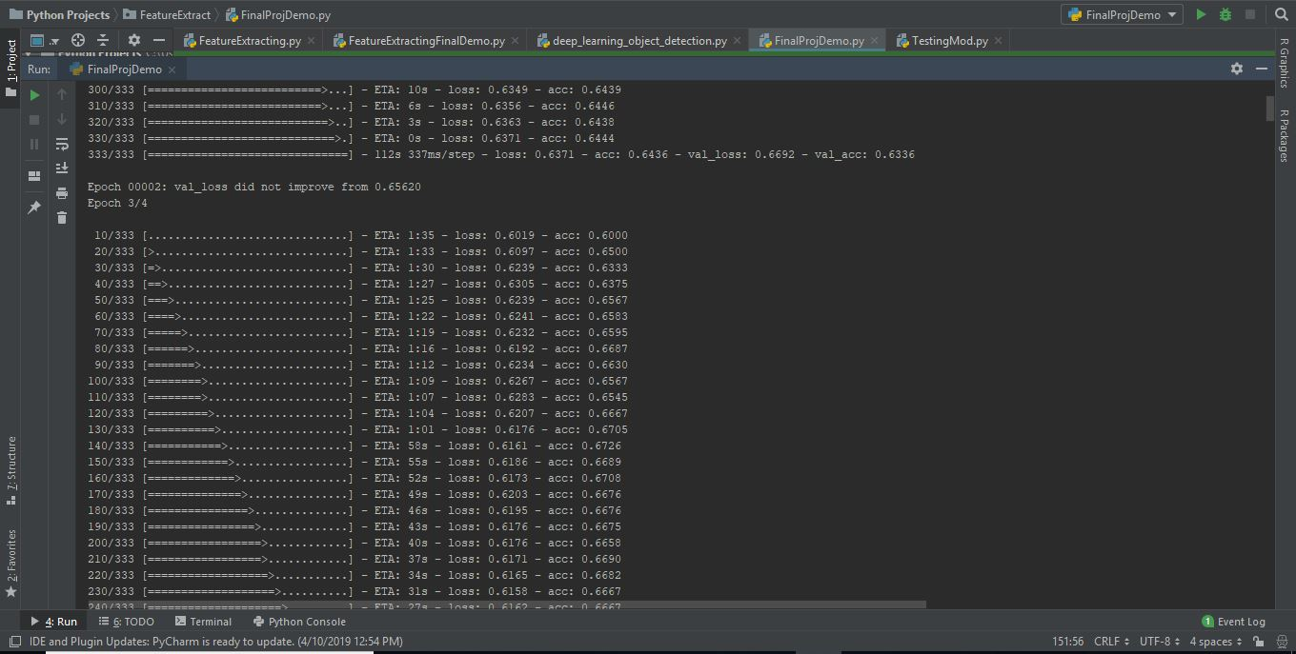

Slide 21
CONCLUSION
About 30 million cattle perish every year due to these unnecessary circumstances. Considering how it affects the farm, it is believed that the death count may be reduced if an effective Unusual Characteristic Identification method were established across all the farms.
This project made use of the Deep Learning and with the help of the SSD and the Sequential model the unusual characteristics such as the behaviour of the animal can be identified before- hand such that the deaths don’t take place.
The dataset consisted of large number of observed images with the characteristics that those images were depicting and characteristics that were measured for were skinny, non-aggression, beefy, foraging, aggression and redness. On comparing the accuracy obtained from different algorithms, the results indicate that the deep learning can be efficiently used for Unusual Characteristic Identification.

Slide 22
FUTURE ENHANCEMENT
Many aspects from the future works can be tackled from this research. Firstly, more animals must be able to be identified and characterized based on their behavior as we have only done it for sheep. Secondly, there can be use of IOT and cloud computing that can help in further enhancing the entire process of not only identifying but also storage of the output for later retrieval purposes.
Though the ultimate classification layer, shown on the terribly right, additionally uses weights across the complete dense block, there looks to be a degree towards final feature-maps, suggesting that there is also some a lot of high-level options made late within the network. By including standard machine learning paradigms, the results obtained opens the field for further research and development of new methods.

Slide 23
REFERENCES
[1] Ella Browning, Mark Bolton , Ellie Owen, Akiko Shoji, Tim Guilford, Robin Freeman, “Predicting animal behavior using deep learning: GPS data alone accurately predict diving in seabirds.”
[2] Chen Chen , Weixing Zhu , Changhua Ma , Yizheng Guo, Weijia Huang , Chengzhi Ruan, “Image motion feature extraction for recognition of aggressive behaviours among group-housed pigs - subgenus.”
[3] Mohammad Sadegh Norouzzadeha, Anh Nguyenb, Margaret Kosmalac, Alexandra Swansond, Meredith S. Palmere, Craig Packere, and Jeff Clune, “Automatically identifying, counting, and describing wild animals in camera-trap images with deep learning.”
[4] André Stuhlsatz, Jens Lippel, Thomas Zielke, “Feature Extraction With Deep Neural Networks by a Generalized Discriminant Analysis.”, (IEEE 2012).
[5] Muhammad Farooq, Edward Sozonov, “Feature Extraction exploitation Deep Learning for Food sort Recognition”, (2017).
[6] Yushi Chen, Hanlu Jiang, Chunyang Li, Xiuping Jia, Pedram Ghamisi, “Deep Feature Extraction and Classification of Hyperspectral Images Based on Convolutional Neural Networks.” (IEEE 2017).

Slide 24
[7] Baptiste Wicht , “Deep Learning feature Extraction for Image Processing.”
[8] Hung Nguyen, Sarah J. Maclagan, Tu Dinh Nguyen, Thin Nguyen, Paul Flemons ,Kylie Andrews, Euan G. Ritchie. Dinh Phun, “Animal Recognition and Identification with Deep Convolutional Neural Networks for Automated Wildlife Monitoring.”
[9] Tibor TRNOVSZKY, Patrik KAMENCAY, Richard ORJESEK, Miroslav BENCO, Peter SYKORA, “Animal Recognition System Based on Convolutional Neural Network.”
[10] Nagaraju Andavarapu and Valli Kumari Vatsavayi, “Wild-Animal Recognition in Agriculture Farms Using W-COHOG for Agro-Security.”

